Slide 1
‘Future Paths’ – Re-imagining local ecumenism through the lens of mission
Churches Together in Essex and East London
Central Baptist Church, Chelmsford, 24th October 2019

Slide 2
Mission-shaped Ben
Cornwall, Cambodia, Cape Town and now CTE

Slide 3
1.The Ecumenical movement is a mission-shaped movement

Slide 4
Ecumenical and mission-shaped?
‘Mission and unity are two sides of the same reality, or rather two ways to describe the same action of the living Lord who wills all should be drawn to himself.’
Newbigin 1961

Slide 5
2. The Missio Dei
‘Mission precedes the Church. Mission is first of all God's: God inside out in the world through the Spirit, God in Jesus teaching, healing, including, suffering. Almost incredibly - as an act of grace! - God shares that mission with women and men. Mission calls the Church into being to serve God's purposes in the world. The church does not have a mission, but the mission has a church. Imagine what church would be like if Christians really understood this and took it seriously. What it means is, first, that the church is not about the church. It is about what Jesus called the Reign of God.’
Bevans & Schroeder 2011

Slide 6
We are invited to participate…

Slide 7
The Missio Dei is…
Communal
Centrifugal
Creative

Slide 8
3. CTE, staff and the Theos report

Slide 9
The Theos Report
1. Continue Cultivating Relationships
2. Clarify Vision
3. Consider a clear focus on mission
4. The public view of ecumenism
5. Speak with one voice

Slide 10
Mosaic of unity movements

Slide 11
Welcome to the table

Slide 13
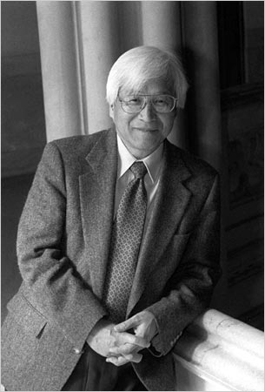
Kosuke Koyama
‘Is the church performing the mission and evangelism of God with the mutilated hands? Are the resources of the church managed by attractive hands or mutilated hands?’ Koyama insists that Jesus moved from the centre to the periphery and we should too

