Slide 2
Major Norman Ord Chair of CTEEL Divisional Commander The Salvation Army Herts & Essex Division

Slide 3
Opening Worship and Prayer

Slide 4
The splendour of a King,
clothed in majesty; let all the Earth rejoice, all the Earth rejoice.
He wraps himself in light, and darkness tries to hide, and trembles at His voice, and trembles at His voice.

Slide 5
How great is our God, sing with me: how great is our God
and all will see how great,
how great is our God.

Slide 6
And age to age He stands, and time is in His hands; beginning and the end,
Beginning and the end.
The Godhead, Three in One, Father, Spirit, Son, the Lion and the Lamb,
the Lion and the Lamb.

Slide 7
How great is our God, sing with me: how great is our God
and all will see how great,
how great is our God.
How great is our God, sing with me: how great is our God
and all will see how great,
how great is our God.

Slide 8
Name above all names, worthy of our praise; my heart will sing: How great is our God.
Name above all names, worthy of our praise; my heart will sing: How great is our God.

Slide 9
How great is our God, sing with me: how great is our God
and all will see how great,
how great is our God.
How great is our God, sing with me: how great is our God
and all will see how great,
how great is our God.

Slide 10
Psalm 92
It is good to give thanks to the Lord, to sing praises to your name, O Most High; ² to declare your steadfast love in the morning, and your faithfulness by night, ³ to the music of the lute and the harp, to the melody of the lyre.
⁴ For you, O Lord, have made me glad by your work; at the works of your hands I sing for joy.

Slide 11
⁵ How great are your works, O Lord! Your thoughts are very deep!
⁶ The dullard cannot know, the stupid cannot understand this: ⁷ though the wicked sprout like grass and all evildoers flourish, they are doomed to destruction forever, ⁸ but you, O Lord, are on high forever.

Slide 12
⁹ For your enemies, O Lord, for your enemies shall perish; all evildoers shall be scattered.
¹⁰ But you have exalted my horn like that of the wild ox; you have poured over me fresh oil. ¹¹ My eyes have seen the downfall of my enemies; my ears have heard the doom of my evil assailants.
¹² The righteous flourish like the palm tree, and grow like a cedar in Lebanon.

Slide 13
¹³ They are planted in the house of the Lord; they flourish in the courts of our God. ¹⁴ In old age they still produce fruit; they are always green and full of sap, ¹⁵ showing that the Lord is upright; he is my rock, and there is no unrighteousness in him.

Slide 14
Prayers

Slide 15
The Pilgrims Prayer
Lord God, we thank you for calling us into the company of those who trust in Christ and seek to obey his will. May your Spirit guide and strengthen us in mission and service to your world; for we are strangers no longer but pilgrims together on the way to your Kingdom. Amen.

Slide 16
Present Landscape

Slide 17
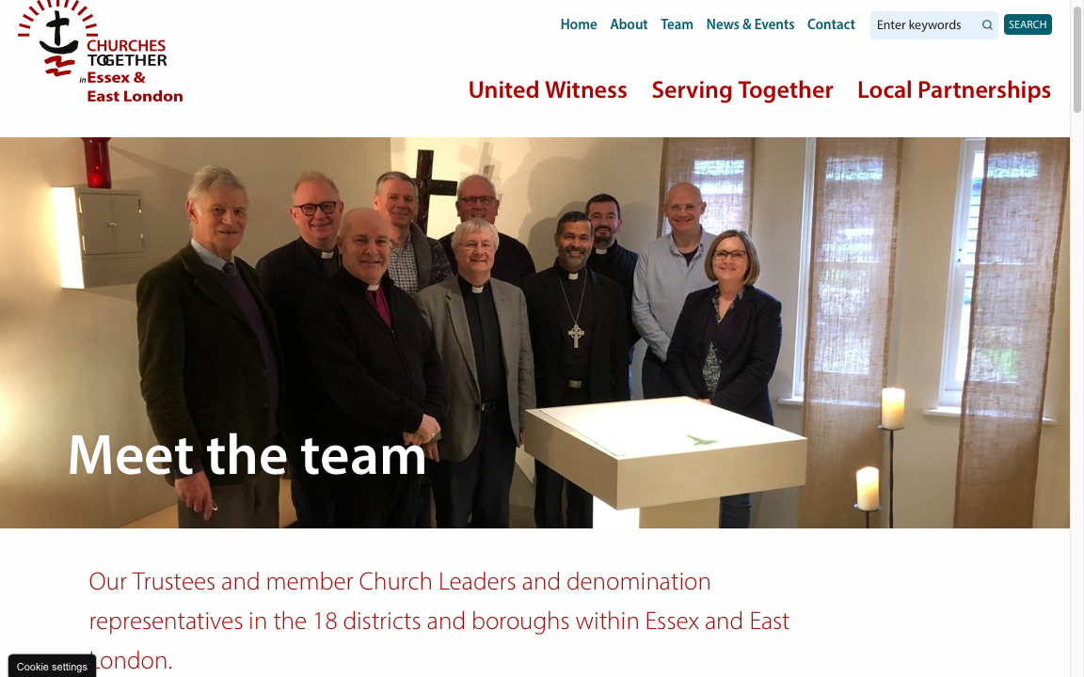

Slide 18
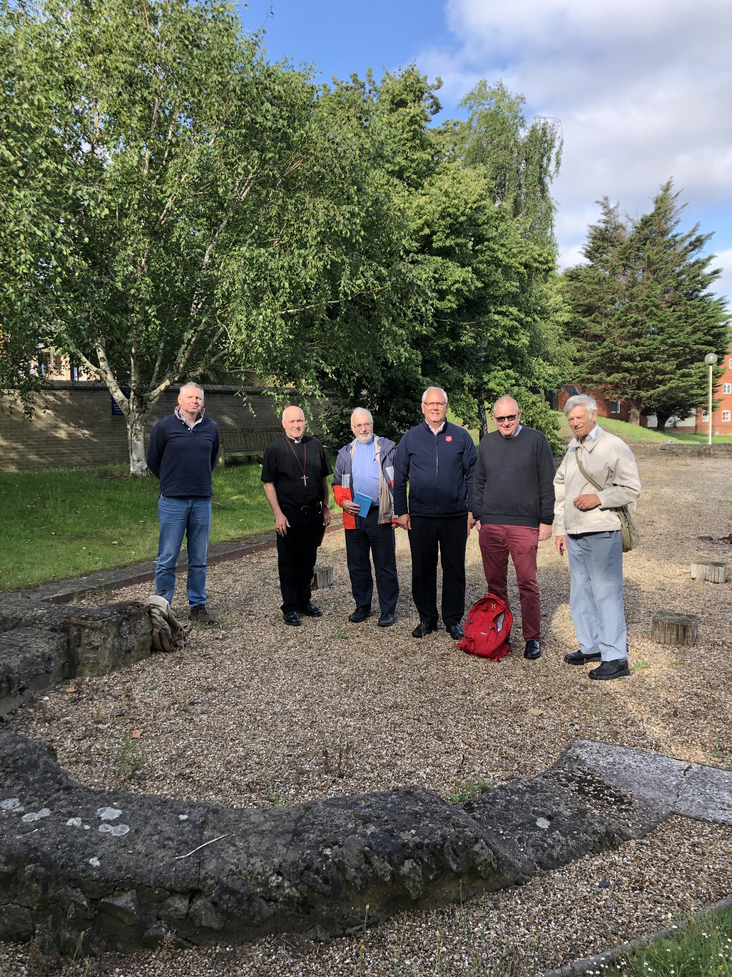

Slide 19
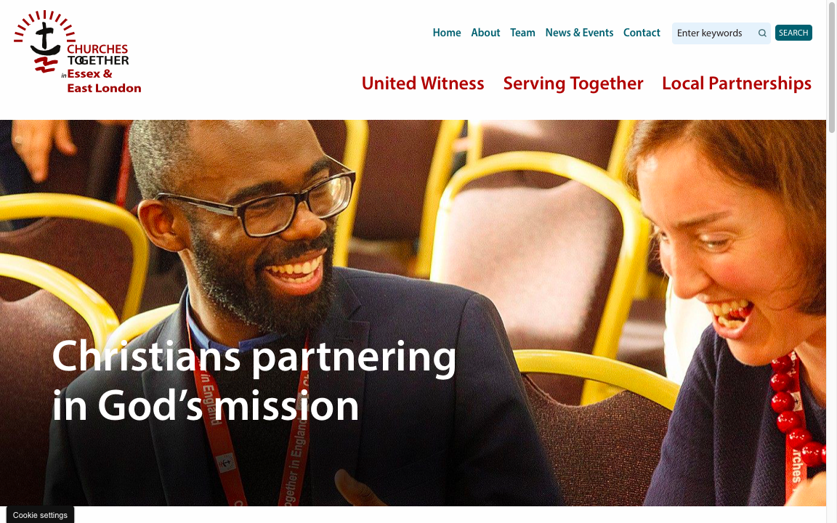

Slide 22
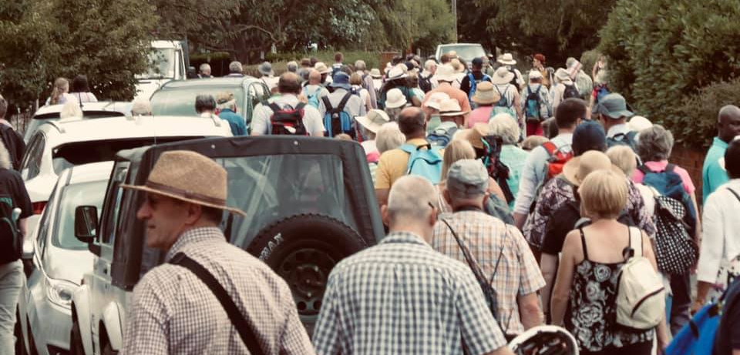

Slide 23
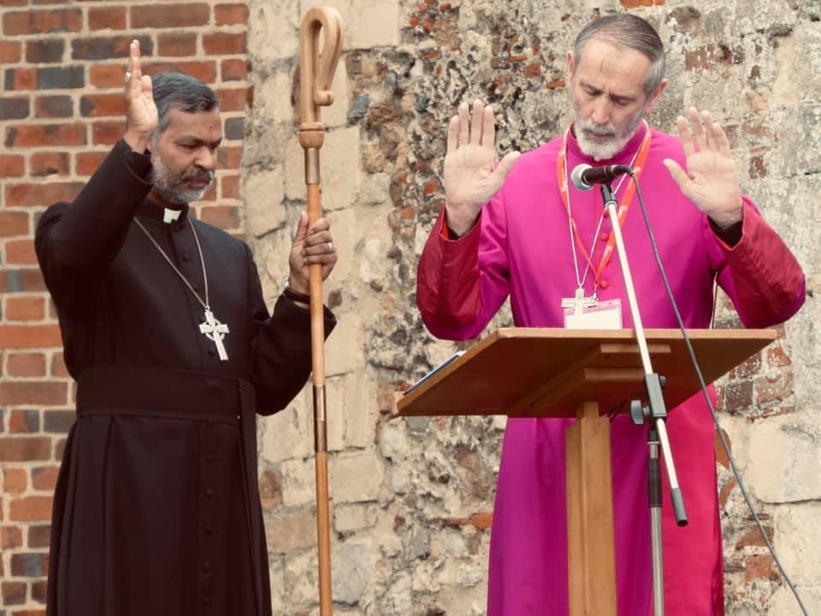

Slide 24
Workplace Chaplains in Essex & East London Mike Lodge

Slide 25
Citizens UK Juliet Kilpin

Slide 26
Refugee Support Stansted 15 Prayers for the Nation and Brexit Meeting with MPs in Westminster Thy Kingdom Come

Slide 28
What it looks like here’
– highlights from local churches together groups

Slide 29
Andy Higgs and Frank Gaisie Transformation Thurrock

Slide 30
David Gilbey Christians Together in Chelmsford

Slide 31
Eve Byles Churches Together in Hutton & Shenfield

Slide 32
Joan Smith Churches Together in Ongar

Slide 33
Chris Boyland Churches Together in Brentwood

Slide 35
Reflections on the mission of CTEEL

Slide 36
Share your thoughts on how CTEEL could help to enable mission within Essex & East London.

Slide 37
Closing Prayers

Slide 38
May the Grace of our Lord Jesus Christ,
and the love of God,
and the fellowship of the Holy Spirit,
be with us all ever more.
AMEN.

